Slide 1
Four Key Business Model
Customer
Value Proposition + Satisfaction
Key
Resources
Key
Process
Profit Formula
Notes:
Ako a na čom dobre zarobiť?
Ako a na čom pomôcť zákazníkovi?
Čo budem robiť ja a čo iní ľudia? Čo budem robiť manuálne a čo budem automatizovať?

Slide 2
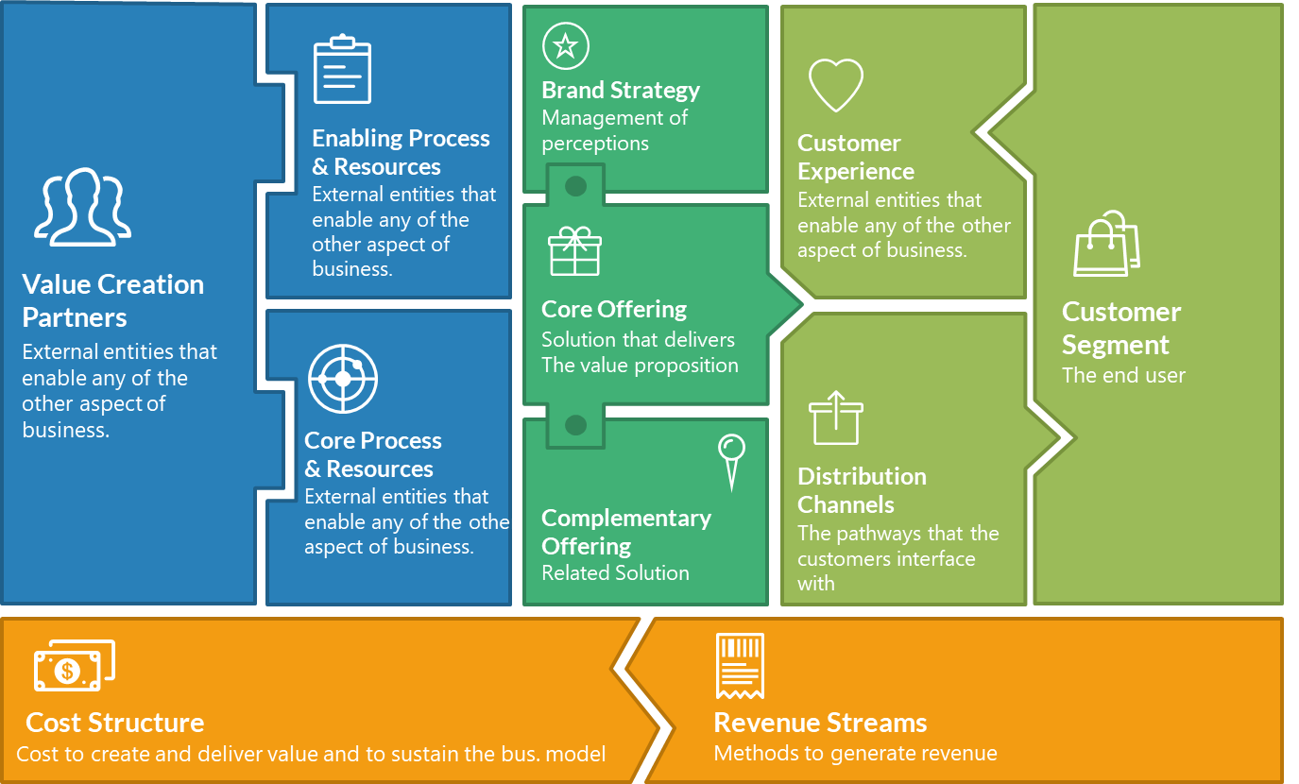
Business Model

Slide 3
Business Model Canvas
Key Partners
Key Activities
Value Propositions
Customer
Relationship
Customer
Segments
Suitable for all category.
Suitable for all category.
Suitable for all category.
Suitable for all category.
Suitable for all category.
Suitable for all category.
Key Resources
Suitable for all category.
Channels
Suitable for all category.
Suitable for all category.
Suitable for all category.
Suitable for all category.
Suitable for all category.
Cost Structure
Revenue Streams
Suitable for all category.
Suitable for all category.
Suitable for all category.
Suitable for all category.
Suitable for all category.
Suitable for all category.

